Slide 1
Input Sets
October 24, 2014
Notes:
Guidewire training materials contain Guidewire proprietary information that is subject to confidentiality and non-disclosure agreements. You agree to use the information in this manual solely for the purpose of training to implement Guidewire software solutions. You also agree not to disclose the information in this manual to third parties or copy this manual without prior written consent from Guidewire. Guidewire training may be given only by Guidewire employees or certified Guidewire partners under the appropriate agreement with Guidewire.
<number>

Slide 2
Identify the parent containers for an Input Set
Describe Input Set reuse and shared logic
Create a shared logic input set
Create a reusable input set
Differentiate between an Input Set and Input Set Ref element
Notes:
<number>

Slide 3
Input set fundamentals
Shared logic input set
Reusable input set
Notes:
<number>

Slide 4
Container widgets
PCF Element
Widget
Location
Atomic Widget
Container Widget
A container widget is a collection of atomic widgets and/or other container widgets
Organizes data and functionality into logical groups
Screen
Input Set
Card View Panel
Detail View Panel
List Detail Panel
List View Panel
Notes:
Container widgets hold other widgets. Each one can be defined either in its own file or as a child container within some other PCF element file.
Both Widget and Location are conceptual representations in this diagram. There are no <Widget /> or <Location /> elements. Similarly, both Atomic Widget and Container Widget are conceptual representations. There are no <Atomic Widget /> or <Container Widget /> elements.
The PCF object model is container-based. Each screen element is modeled as an object, which may contain other objects. The hierarchical structure simplifies the task of locating and modifying visual elements. Furthermore, each element can be declared as an independent and therefore reusable element.
<number>

Slide 5
Container hierarchy
Screen
A reference widget in a parent container references a PCF File as an embedded child container
An InputSetRef widget can reference an Input Set
Card View Panel / List Detail Panel
Detail View Panel
List View Panel
Input Set Ref
Input Set
Atomic Widgets
Notes:
An input set can contain child input sets. An input set can be added to an input column defined within a detail view panel. An input set can referenced within an input column defined within a detail view panel. To reference an input set, you use an InputSetRef widget.
In practice, Studio automatically adds an input column to a detail view panel if you attempt to add an input set where there is not already an input column.
Although not reflect in the diagram, an input set can contain a List View Input that references a list view panel. In practice, there is not a frequent need to include a list view panel in an input set.
<number>

Slide 6
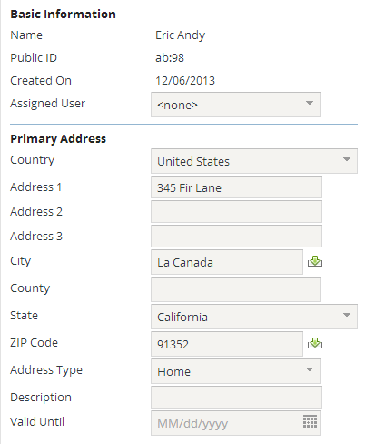
Container widgets: Input Sets
An input set is a named group of widgets
Can contain atomic widgets
Can be reused by detail view panels
Cannot be referenced by secondary views
Cannot have a toolbar directly associated with it
Reuse single set of inputs across multiple detail view panels
Apply visibility or editability logic across multiple widgets
Input Set
Notes:
An input set groups together a set of widgets. There are two types of input sets: InputSet widget and Input Set PCF file.
An InputSet widget groups together input widgets and allow developers to apply shared logic to the grouped widgets. An InputSet widget is an inline widget within an input column of a detail view panel.
An Input Set PCF allows developers to create a group on input widgets within a file. An Input Set PCF can be referenced by one or more PCF files. Input Set PCFs allow for reuse.
<number>

Slide 7
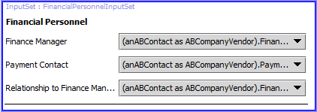
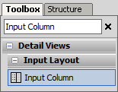
Widgets for input sets
Input sets can contain
Input widgets
Input dividers
Label widgets
List view panels
Other input sets!
Input sets cannot contain
Input columns
Notes:
Unlike detail view panels, input sets cannot contain columns.
<number>

Slide 8
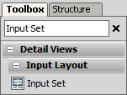
Resuable PCF file or inline widget
Input Set PCF File
InputSet widget
Resuable PCF file
Takes root object
File name ends with InputSet
Inline widget, not reusable
Inherits parent object
Shared logic
Exercise control over all elements
Input Set PCF
Notes:
When a container such as a input set is a top-level container, it is reusable. A top-level container is a PCF file. If the container is likely to be needed in multiple places, create a PCF file for the container. An Input Set is PCF file that is ideal for multiple references. Other PCF files can reference the reusable container using a reference widget. InputSetRef widgets are discussed later in this lesson.
When a container such as input set is declared as an inline child container, it is not reusable. Other containers cannot reference an inline container. A InputSet widget is defined in a Detail View Panel or another Input Set. It is possible to define a variable object for an InputSet widget, but this is uncommon. An InputSet widget inherits the root object associated with its parent.
The two use cases for input sets—reusability and shared logic—are not mutually exclusive. It is possible to have an input set that extends a single visible or editable condition across its contents and gets reused under multiple circumstances. In this regards, input sets often apply visibility or editability logic for a group of widgets.
<number>

Slide 9
Input set fundamentals
Shared logic input set
Reusable input set
Notes:
<number>

Slide 10
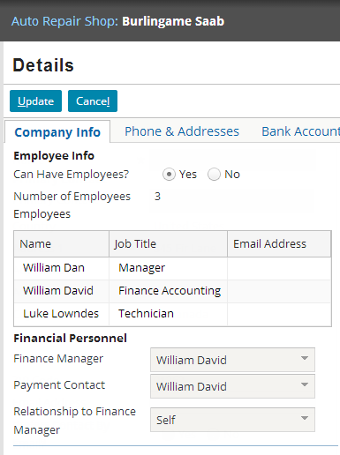
Input set shared logic
Group the visibility and/or editable property conditions for a set of widgets
Widgets placed within input set
Visibility and/or editability set at input set level
Example:
If the root object is of type ABCompanyVendor, then FinancialPersonnelInputSet is visible
Notes:
It is also possible to set an editable or visible property for an InputSet widget. The input set property applies to all the contained widgets within the input set. In this manner, you can eliminate the need to configure the individual widget properties for a group of related widgets.
<number>

Slide 11
Steps to create a shared logic input set
Add an InputSet widget
Specify shared logic
Add atomic widgets
Deploy PCF
Notes:
<number>

Slide 12
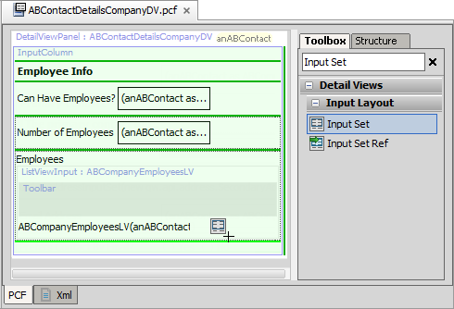
Step 1: Add an InputSet widget
Light green line - current place where new widget will go
Dark green line - places where new widget can go
Add an InputSet widget
In an Input Column within a Detail View Panel
Can reference parent container variables
Notes:
<number>

Slide 13
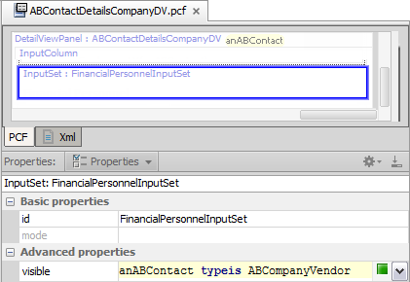
Step 2: Specify shared logic
Input set is parent container for its child widgets
Editable and or Visible properties affect all child widgets of the input set
Example:
Visible is true when object is of the type ABCompanyVendor
typeis is a Gosu operator to compare object to a type
Notes:
<number>

Slide 14
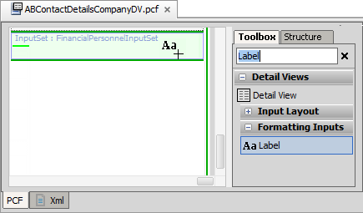
Step 3: Add atomic widgets
Select the best input for the data type from the Toolbox
Specify required and optional properties
Notes:
Add an atomic widget as you would for a detail view panel.
<number>

Slide 15
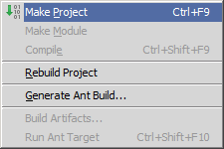
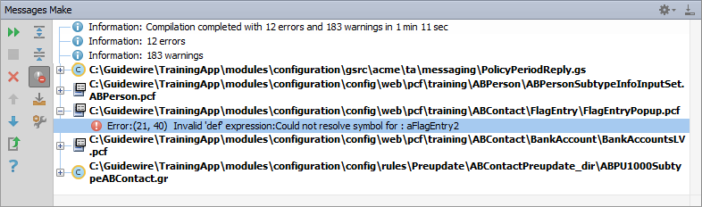
Make project to see all PCF errors
Build → Make Project
Compiles only modified files since the last compilation
Opens Messages (Make) window for build summary
Filter for errors
Great way to see all PCF errors
Notes:
Make Project: All the source files in the entire project that have been modified since the last compilation are compiled. Dependent source files, if appropriate, are also compiled. Additionally, the tasks tied to the compilation or make process on modified sources are performed.
<number>

Slide 16
Step 4: Deploy PCF
Restart Server
Reload PCFs
PCFs read at server startup
ALT+SHIFT+L
Internal debug tools enabled
Internal Tools
Reload → Reload PCF Files
Detail View Panel PCF
Detail View Panel PCF
Notes:
It is also possible to reload PCF files using the Guidewire API and/or internal server tools. The Reload PCF command can be found on the Reload page in Internal Tools. To access Internal Tools, the EnableInternalDebugTools setting in the config.xml file must be set to true. The keystroke to open the Internal Tools page is ALT+SHIFT+T. In the tab bar, select Internal Tools --> Reload. On the Reload page, click the Reload PCF Files button. Both the keystroke ALT+SHIFT+L and the Reload PCF Files button call the same static method: gw.api.tools.InternalToolsUtil.reloadPCFs().
<number>

Slide 17
Input set fundamentals
Shared logic input set
Reusable input set
Notes:
<number>

Slide 18
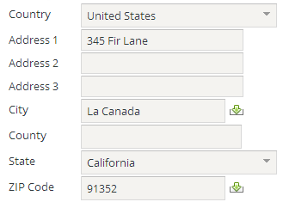
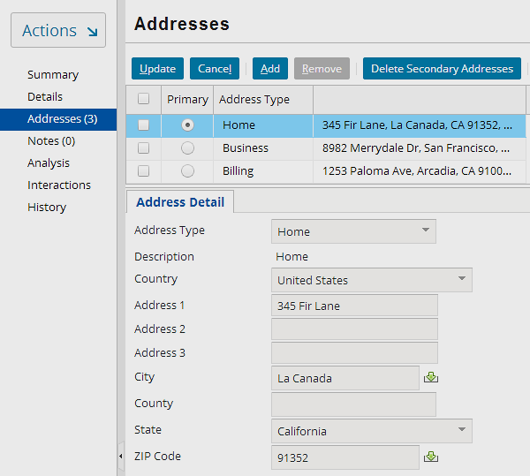
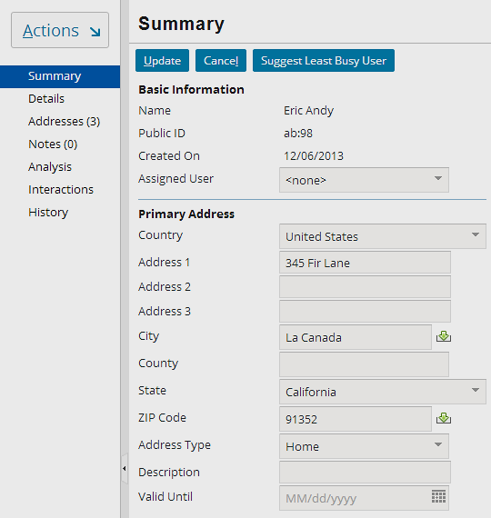
Input set reusability
ABContactAddressesLDV
GlobalAddressInputSet .default
ABContactSummaryDV
Notes:
GlobalAddressInputSet is a globalization input set and is modal. Modal widgets are discussed in greater detail later in this course. It is not a requirement for a PCF to be modal in order for it to be reused.
Input sets often define a set of widgets that are reused in multiple detail view panels. Reuse of widgets as an input set reduces and simplifies development, configuration, and administration.
<number>

Slide 19
Steps to create a reusable input set
Create an input set PCF
Specify required variable(s)
Add atomic widgets
Reference the input set from parent
Deploy PCFs
Notes:
<number>

Slide 20
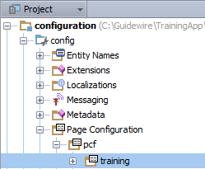
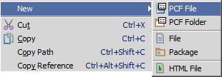
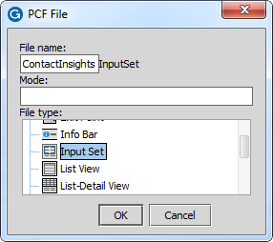
Step 1: Create an input set PCF
"InputSet" appended to file name
In Project View, select a PCF Folder in …\config\ Page Configuration\pcf\
Context menu → New → PCF File
Enter File Name and select Input Set as file type in PCF File dialog
Notes:
<number>

Slide 21
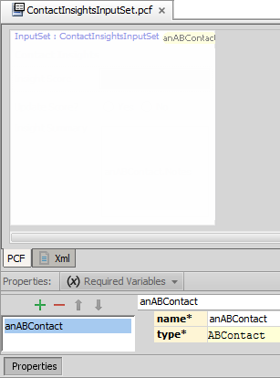
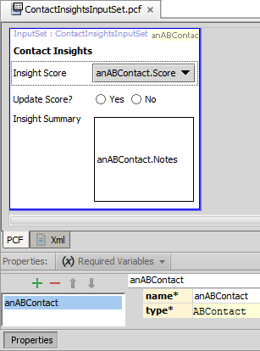
Step 2: Specify required variable(s)
Required Variables tab
Defines data object variable name and type
Example: anABContact is of type ABContact
Object data can be
Data backed (database)
Virtual property
Container data comes from defined variable object(s)
Referred to as root object
Notes:
Most container widgets have at least one required object that contains data fields. One way to think of this is that there is at least one root object for a given container.
<number>

Slide 22
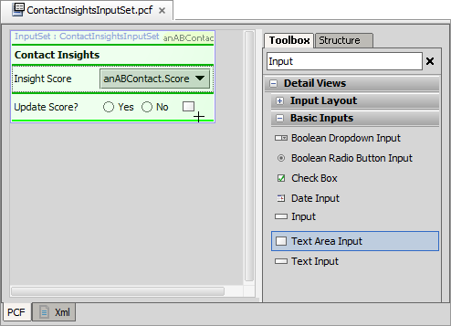
Step 3: Add atomic widgets
Select the best input for the field data type from the Toolbox
Specify required and optional properties
If required, bind the widget data
Root object field, subtype object field, related object field
Notes:
Atomic widgets are added to an input set in the same way that they are added to a detail view panel. To add a widget, click its name in the Toolbox and hold the mouse cursor down. As you begin to drag the widget, Studio changes the mouse cursor so that it includes the icon for that widget. Studio places a green line on the canvas at every location on the canvas that it is possible to place the widget. Studio highlights the green line that is nearest on the canvas to the cursor. Studio also overlays in green the element containing the highlighted green line.
All PCF elements have definable properties in the Properties window. To view properties of a PCF file, click its title link in the upper-left corner. To view properties of any element, click that element. The Properties window contains multiple property tabs. Click a tab to edit the associated properties. Some properties are not editable. Other properties are required. Required properties have an asterisk and the property name appears against a yellow background. If you select a property, variable, or entry point, an "X" icon appears on the right-hand side of the cell for that property, variable, or entry point. You can click the "X" to restore the selected property, variable, or entry point to its default value. The Properties window validates each property expression and/or and value.
Most atomic widgets require IDs. However, some widgets, such as labels and dividers, do not require IDs. The value property defines the data field. You specify a field using dot notation. You can reference a direct object field or related object field. If the field is a "data" field, you can set the editable property of the widget to "true". Only data fields are editable.
<number>

Slide 23
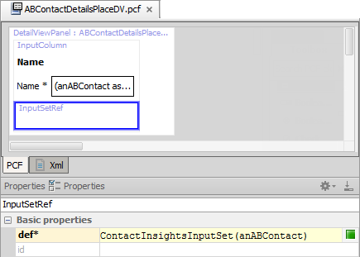
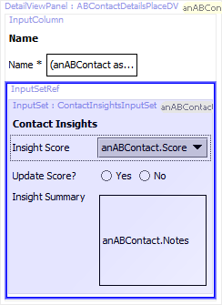
Step 4: Reference the input set from parent
Input Set
root object
Add an InputSetRef widget to the parent container
Define the def property
Specify the input set
Pass the required object type as an argument
Notes:
A PanelRef widget references a detail view panel. In a similar manner, an InputSetRef widget references an input set. An input set can be added or referenced only inside a detail view panel input column. The PCF Editor in Guidewire Studio automatically adds an input column to a detail view panel if you attempt to add an input set ref where there is not already an input column.
To reference an input set from a parent container:
Add an InputSetRef widget at the appropriate place in the parent container.
In the input set ref's def property, specify the input set name. After the name, inside parentheses, specify the required object(s) to pass to the input set.
In the slide example, ABContactDetailsPlaceDV defines an root object named anABContact. ABContactDetailsPlaceDV contains a newly added Input Set Ref. The Input Set Ref requires a value for the def property. The def property references the Input Set named ContactInsightsInputSet. The def property passes the anABContact root object as argument to ContactInsightsInputSet.
Similar to the Input Set itself, an Input Set Ref has editable and visible widget properties. Setting these properties affect the referenced Input Set.
<number>

Slide 24
Make project to see all PCF errors
Build → Make Project
Compiles only modified files since the last compilation
Opens Messages (Make) window for build summary
Filter for errors
Great way to see all PCF errors
Notes:
Make Project: All the source files in the entire project that have been modified since the last compilation are compiled. Dependent source files, if appropriate, are also compiled. Additionally, the tasks tied to the compilation or make process on modified sources are performed.
<number>

Slide 25
Step 5: Deploy PCFs
Restart Server
Reload PCFs
PCFs read at server startup
ALT+SHIFT+L
Internal debug tools enabled
Internal Tools
Reload → Reload PCF Files
Detail View Panel PCF
Input Set PCF
Detail View Panel PCF
Input Set PCF
Notes:
It is also possible to reload PCF files using the Guidewire API and/or internal server tools. The Reload PCF command can be found on the Reload page in Internal Tools. To access Internal Tools, the EnableInternalDebugTools setting in the config.xml file must be set to true. The keystroke to open the Internal Tools page is ALT+SHIFT+T. In the tab bar, select Internal Tools --> Reload. On the Reload page, click the Reload PCF Files button. Both the keystroke ALT+SHIFT+L and the Reload PCF Files button call the same static method: gw.api.tools.InternalToolsUtil.reloadPCFs().
<number>

Slide 26
Identify the parent containers for an Input Set
Describe Input Set reuse and shared logic
Create a shared logic input set
Create a reusable input set
Differentiate between an Input Set and Input Set Ref element
Notes:
<number>

Slide 27
What are the two primary use cases for input sets?
Which of the following can be included in input sets:
Embedded list views
Inputs
Input columns
Input dividers
Labels
What is the difference between the "input set" widget and the "input set ref" widget?
Notes:
Answers
1) Reuse of widgets across detail view panels and/or logic shared for a group of widgets such as editability and/or visibility.
2a) Yes
2b) Yes
2c) No
2d) Yes
2e) Yes
3) The InputSet widget groups widgets together and is placed within an input column within a detail view panel. You use an InputSetRef widget to reference an Input Set PCF file. An Input Set PCF can be referenced by one or more InputSetRef widgets. Input Set PCFs are reusable input sets.
<number>

Slide 28
Notes:
<number>

